Slide 1



Overview
Premium paid by the customer is the major revenue source for insurance companies. Default in premium payments results in significant revenue losses and hence insurance companies would like to know upfront which type of customers would default premium payments.
Explore the data to identify customers with the propensity to default on the
Premiums to be paid to the Insurance company.
www.free-powerpoint-templates-design.com
Notes:
The dependent variable is binary and categorizes customers into defaulters & non-defaulters of payments for the insurance premium. Our exploration and predictive analysis will consist of exploring the dataset among all the various variables to discover patterns, similarities, behavior and other attributes' which will help us identify the cohort of customer who have a propensity to default on their next premium. The idea is to identify – target – offer effective and adaptive alternatives and solutions to make it easy for them continue paying their premiums on time.

Slide 2
Independent Variables to be explored
Marital Status
Premium
Nos. of Dependents
Vehicle owned
Risk Score
Premium paid Late
by 6 to 12 months
Income
Sourcing Channel
Num of Premium Paid
Accommodation
Age
Residence Area
Premium paid Late by more than 12 months
Premium Paid in Cash
Premium paid Late by 3 to 6 months
www.free-powerpoint-templates-design.com
Notes:
We have 15 variables which we need to explore and analyze w.r.f. to the dependent variable (Default). Of these variables 88% of data is continuous in nature. We will need to treat these variables accordingly to explore them to our requirement.

Slide 3
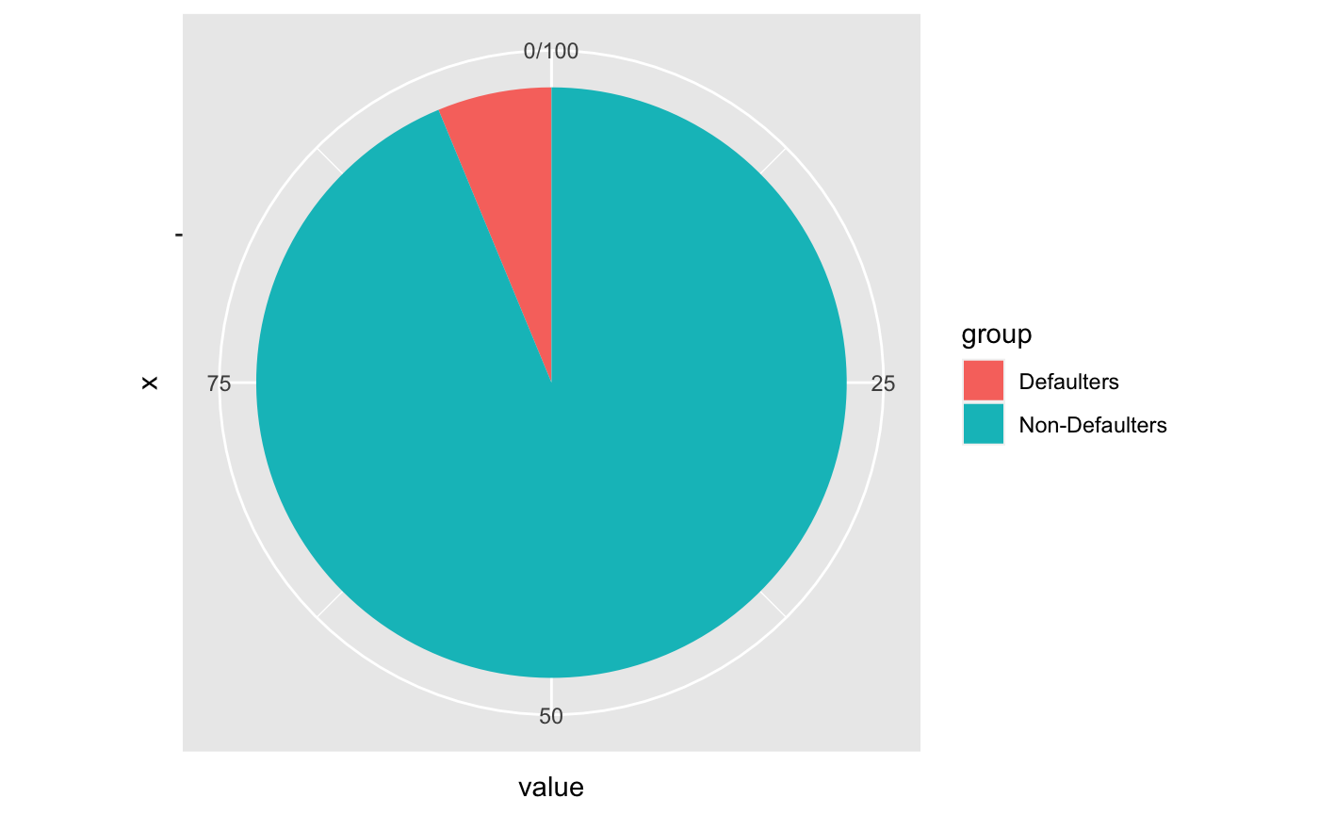
Exploring the unbalanced Data
6.25%
An unbalanced data is a challenge to explore and filter the information/cohorts especially if we have 16 variable to dig into
93.75%
Notes:
The data is unbalanced with regards to the dependent variable, i.e. only 6.25% of the cohorts are defaulters who have defaulted in their last premium payment. We have to compare this cohort with the previous default data and also understand how and when the delinquents convert to defaulters. Need to understand the influencers and factors for their behavior or lack of it to identify them appropriately and address their issues to have them as non-defaulters.

Slide 4
Exploring various attributes to identify the potential defaulters among the cohorts
Premium late by 6 to 12 months
Potential Defaulters
Exploring Categorical & Numerical Data to discover patterns, similarities, correlations, user behaviors, etc. to identify the potential defaulters
Age
Percentage of premiums paid by cash
Risk
Score
Premium late by more than 12 months
Income
Premium late by 3 to 6 months
www.free-powerpoint-templates-design.com

Slide 5
Solution Design
The journey of exploring the data for identifying the potential defaulters
Clean & Filter Data
Uni Variant Analysis
Bi Variant Analysis
Correlation Analysis
Building Analytical Models
Finalize/ Select
Model
Identify
Important
variables
Insights
&
Recommendations
1
2
3
4
5
6
7
8
Data Treatment
EDA
Uni Variant
EDA
Bi Variant
Correlation
Building
Basic Models, Bagging & Boosting
Best Model for Analysis
Important Variables
Findings & Solutions
Missing Value
Outlier Treatment
Variable Transformation
Adding/removing variables
Column Names
The categorical and numerical variables explored to check on aspects like the mean, median, mode, outliers and other influencing aspect of each variable individually.
see how the dependent variable (Defaulter) is behaving amidst all the categorical and numerical variables.
understand the degree of correlation and if they would be any high correlations which we need to consider for our analysis.
Model performing best of aspects like:
Confusion Matrix
Accuracy
Specificity
Sensitivity
Precision
AUC
Gini
Concordance
Discover the important influencing variables which indicate pattern, user behavior, tendency, characteristics and introspect to come out with solutions & recommendations
Long Term – Short term
One Fit or tailored solution model
Conclusion
Recommendations with some real- world example
CART model
Logistic Regression Model
Naïve Bayes
KNN
Random Forest
Gradient Boosting
XG Boost
www.free-powerpoint-templates-design.com

Slide 6
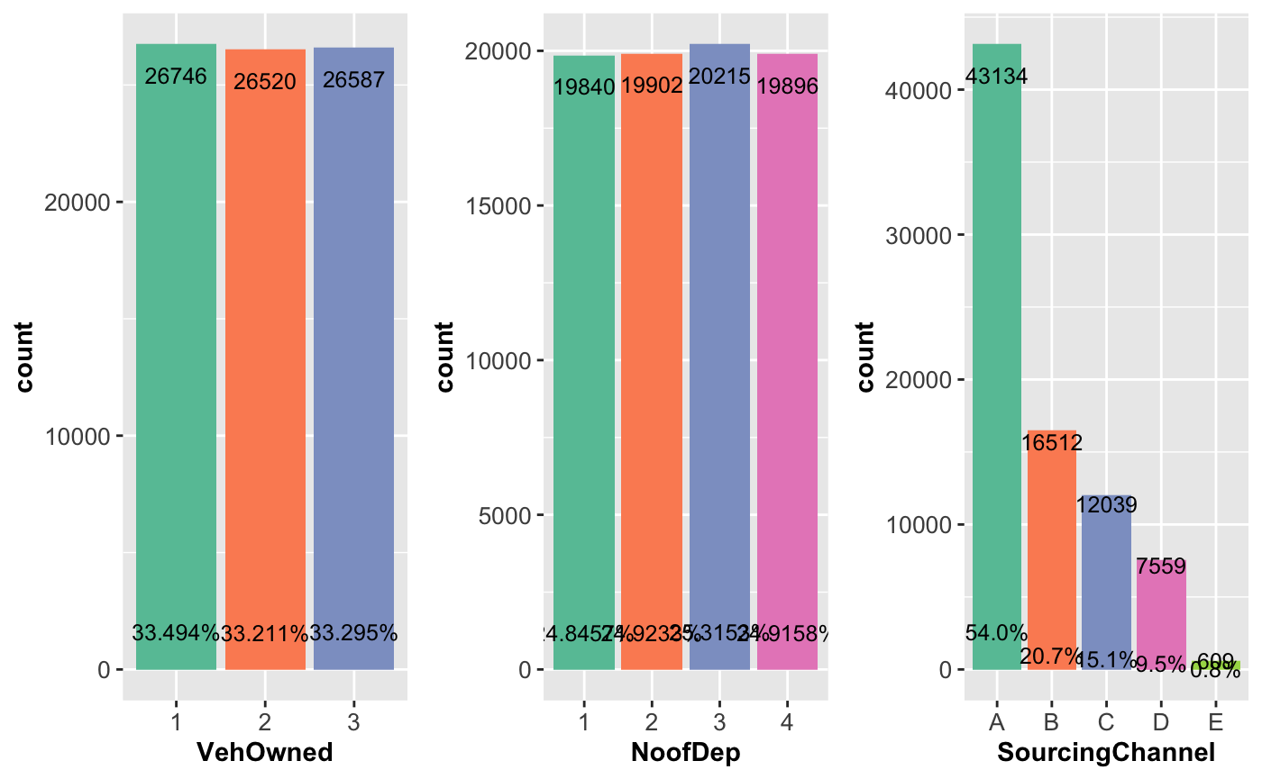
Uni Variant Analysis of Categorical variables
Notes:
Sourcing Channel A dominates among all Channels with more than double the counts of any other sources.

Slide 7
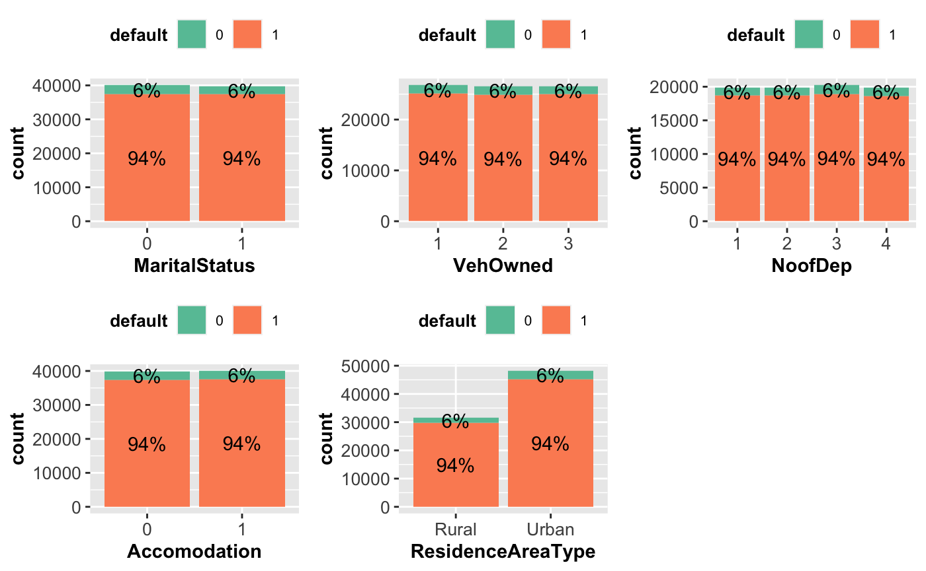
Bi Variant Analysis of Categorical variables
Notes:
The behavior of the depeneant variable seems almost similar with each categorical variable. Will need to explore and analyze it deeper.

Slide 8
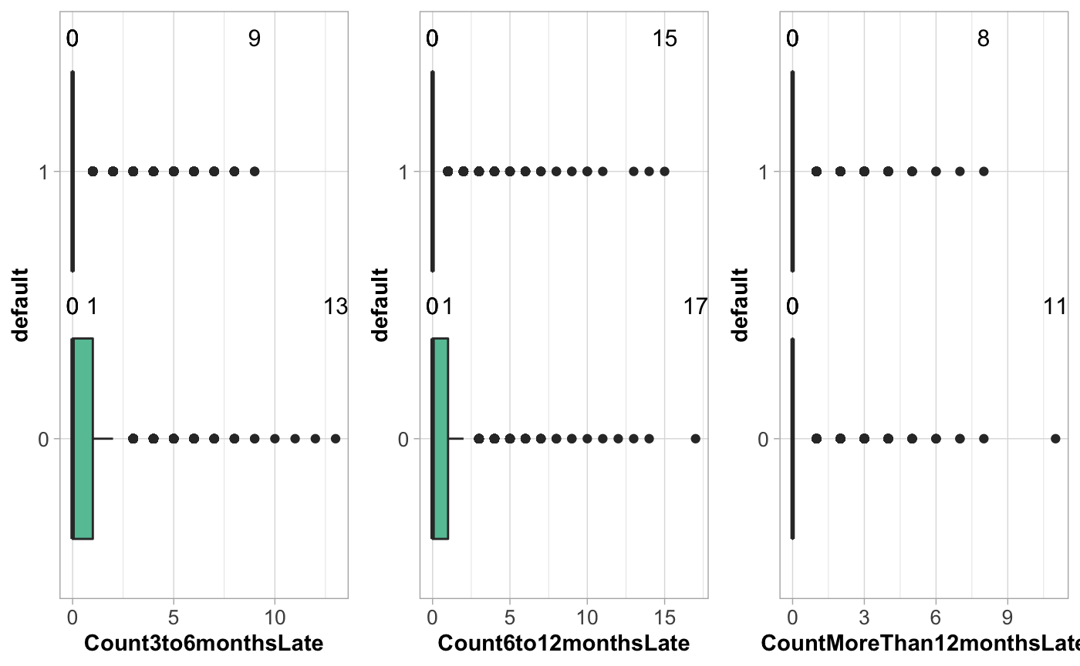
Bi Variant Analysis – old vs new defaulters
Identifying the pattern of the defaulters with the cohorts who have been late in paying their premiums by
- 3 to 6 months
6 to 12 months
More than 12 months
Notes:
We see the default variable showing similarities in the 3 to 6 and 6 to 12 cohorts. We will need to analyze deeper to see how these variable help identify a pattern and correlation with each other.

Slide 9
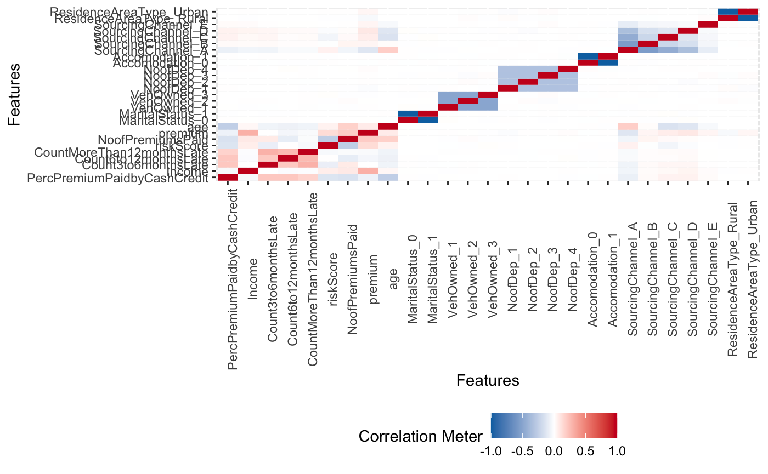
Correlations among all variables
No High Correlation among any variables
Notes:
No high correlation witnessed among any variables. Comparatively a correlation is seen between Income & Premium followed by Premium Paid in Cash with all the 3 late counts for paying premiums, and between each of the three late premium payment variables. Age and Sourcing Channel A is showing some correlation as well.

Slide 10
Analytical Models
Basic Models
Will apply a Supervised Machine Learning Technique for a Descriptive, Predictive & Prescriptive Analysis
Decision Tree
classification method
Nearest neighbors
Regression
Naïve Bayes
CART
Logistic
Regression
KNN
Supervised Machine Learning Technique
Probability of the given feature vector being associated with a label
Built a CART model on the train data. -- create CART model 1 & validate for accuracy.
-- Tuning the model: further tune the model for further accuracy
Model Validation: validate the new model
Model Evaluation: evaluate both the models on the test data & compare their accuracy.
+ Tune the model and prune the tree, if required.
+ Test the data on test set.
Logistic function to model the conditional probability
classify new data points based on similarity measure
the algorithm expects the features to be independent which is not always is the case.
In the case of binary classification the probability of defaulting premiums and not defaulting premiums will sum up to 1
Classification is done by a majority vote to its neighbors. The data is assigned to the class which has the nearest neighbors.
As you increase the number of nearest neighbors, the value of k, accuracy might increase.
www.free-powerpoint-templates-design.com
Notes:
After splitting the data between Train & Test for analytical analysis, we will treat the train data set with Synthetic Minority Over-sampling Technique (SMOTe) for Imbalanced Datasets. This is done to handle the bias in a imbalanced data with regarding to the minority class.

Slide 11
Analytical Models Bagging & Boosting
Process will involve creating a Train & Test Data set from the original data set. The training data set will be used to validate each model and the same will later be used to evaluate the model on the test data set.
Boosting
Bagging
Gradient
Boosting
Boosting
Random
Forest
X G Boost
machine learning boosting
It relies on the intuition that the best possible next model, when combined with previous models, minimizes the overall prediction error.
an ensemble method that trains several decision trees in parallel with bootstrapping followed by aggregation
Efficient to the Gradient Boosting
Extreme Gradient Boosting (XGBoost) is similar to gradient boosting framework but more efficient. It has both linear model solver and tree learning algorithms. What makes it fast is its capacity to do parallel computation on a single machine..
-- Incase there is no significant improvement in the CART model from the baseline model, we build the Random Forest.
-- Tune the Model
-- Model Validation: validate the new model
-- Model Evaluation: evaluate both the models on the test data & compare their accuracy.
www.free-powerpoint-templates-design.com

Slide 12
Confusion Matrix
Indication towards extracting “defaulters’ & ‘non-defaulters
CART MODEL 1 | Defaulters | Non-Defaulters
Defaulters | 173 | 826
Non - Defaulters | 218 | 14753
CART MODEL 2 | Defaulters | Non-Defaulters
Defaulters | 0 | 999
Non - Defaulters | 0 | 14971
Naïve Bayes | Defaulters | Non-Defaulters
Defaulters | 0 | 3
Non - Defaulters | 999 | 14968
Logistic Regression | Defaulters | Non-Defaulters
Defaulters | 122 | 96
Non - Defaulters | 877 | 14875
KNN | Defaulters | Non-Defaulters
Defaulters | 98 | 901
Non - Defaulters | 103 | 14868
Gradient Boosting | Defaulters | Non-Defaulters
Defaulters | 147 | 852
Non - Defaulters | 126 | 14845
Random Forest 1 | Defaulters | Non-Defaulters
Defaulters | 159 | 840
Non - Defaulters | 154 | 14817
Random Forest 1 | Defaulters | Non-Defaulters
Defaulters | 2 | 997
Non - Defaulters | 0 | 14971
XG Boost | Defaulters | Non-Defaulters
Defaulters | 113 | 886
Non - Defaulters | 81 | 14890

Slide 13
Overview: Models Analysis
Models | Accuracy | Sensitivity | Specificity | Precision | KS | AUC | Gini | Concordance
Cart Model 1 | 0.93 | 0.92 | 0.01 | 0.92 | 0.5 | 0.80 | 0.03 | 0.17
Cart Model 2 | 9.374452e-01 | 9.374452e-01 | 0.00 | 9.374452e-01 | 0.00 | 5.0 | -2.27 | 0.00
Random Forest 1 | 0.93 | 0.92 | .009 | 47.33 | 0.50 | 0.81 | 0.05 | NaN
Random Forest 2 | 9.375704e-01 | 9.375704e-01 | 1.252348e-04 | 7.48 | 5.111567e-01 | 8.177137e-01 | 1.159270e-02 | NaN
Logistic Regression | 0.93 | 0.93 | 0.007 | 0.93 | 0.5 | NA | 0.03 | NaN
Naïve Bayes | 0.93 | 0.93 | 0.00 | 0.93 | 0.51 | NA | 0.0001 | NaN
KNN | 0.93 | 0.93 | 0.006 | 73.97 | 0.39 | 0.72 | 0.043 | NaN
Gradient Boost | 0.93 | 0.92 | 0.009 | 0.92 | NA | 0.82 | NA | NaN
X G Boost | 0.93 | 0.93 | 0.007 | 0.93 | 0.51 | 0.82 | 0.02 | NaN
Notes:
CART Model 1 gives the best result in Specificity compared to other models.. On the other attributes too it performs better than or as good as the other models.

Slide 14
Most Important & Influencer variables
Late in Payment of Premiums
Late by 3 to 6 Months
Late by 6 to 12 months
Late by more than 12 months
Important
Influencing
Variable to deep dive
Paying Premiums in Cash Credit
Cash in hand to pay Premium is a major attribute for paying Premiums
Risk Score
High Income = High Risk -Score = Low Defaulters
Income
High Income = Low Defaulters
Late in Payment of Premiums
Paying Premium in Cash
Risk Score
Income
www.free-powerpoint-templates-design.com
Notes:
The variable influencing majorly to identify potential defaulters include the above 7 attributes. Understanding the factors we come out with appropriate options/solutions for customers to manage paying their premiums on time.

Slide 15


Key Findings
01
Looking at customers who are late in paying premiums in all 3 categories. They seem to follow a common pattern. Also, the risk score is a good indicator here as low risk score customer tend to have defaulted on the payments.
02
Paying Premiums in Cash Credit seems like a stumbling block for some customers. Look at solutions to manage this issue by creating options towards offering insurance types and subsequent premiums.
03
Income seems an influencing factor. We comparatively see lesser defaulters amidst the higher income bracket
04
Interactive – Engaging – Incentive based options
05
Flexible, customized, tailored payment options for eligible customers
www.free-powerpoint-templates-design.com

Slide 16
Recommendation
You can download professional PowerPoint diagrams for free
Short term vs Long Term Options
Rather providing a long term offering, what needs to be offered would be a solution which addresses the current issue in hand and something that will rightly fit in their scheme of things.
A comprehensive but simple product which is easy to issue and pick needs to be developed.
01
Is capability to make Payment the only reason to Default?
02
Convenience, simplified product, easier issuance of insurance could at times solve the lethargy of not prioritizing the payments towards your premiums.
Options for cashless service, credit service, EMI offerings, deferring options (case basis), etc. can be offered to pay premiums timely
Solution bases customized offering (Sachet, Bouquet, etc.)
03
Relevant and simpler options could at times be easier to pick up especially during the challenging times like the pandemic when work, business, jobs and earnings are a challenge.
01
02
03
04
Interactive – Engaging – Incentive based options
04
Coming up with easy to adapt and engage programs for the customers by which one can achieve solutions for the insurer and the insured.
We need to keep in mind the current economic fallout due to the pandemic and the impact it has had on jobs/ business/income when we come our with solutions for the payments of the premiums.
www.free-powerpoint-templates-design.com

Slide 17

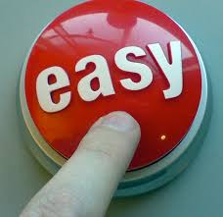


Changing the Customer Mindset
outlook towards priority for health – insurance – paying premium
Incentivize customers for having health priorities
* Solutions should be from customer perspective and not a push to simply collect premiums.
* Look at the issues from customers stand-point
* Push to make the customer a healthier person which has advantages for the individual and the insurer
*Develop products, schemes, programs to incentivize those who maintain a regular healthier lifestyle
Cashless
alternatives
Convenience
to
participate
incentives
Interactive
Cash benefit programs which would include lesser premiums as per healthier lifestyle, deferred period of payments for customers showing a healthier trend.
Regular incentives on milestones which offers discounts, freebies, add-ons for encouraging fitness on a daily basis.
Easy to adopt solutions (like loading app on customer’s handset) and interactive options for easy participation to keep customers interested, engaged and encouraged.
www.free-powerpoint-templates-design.com

Slide 18
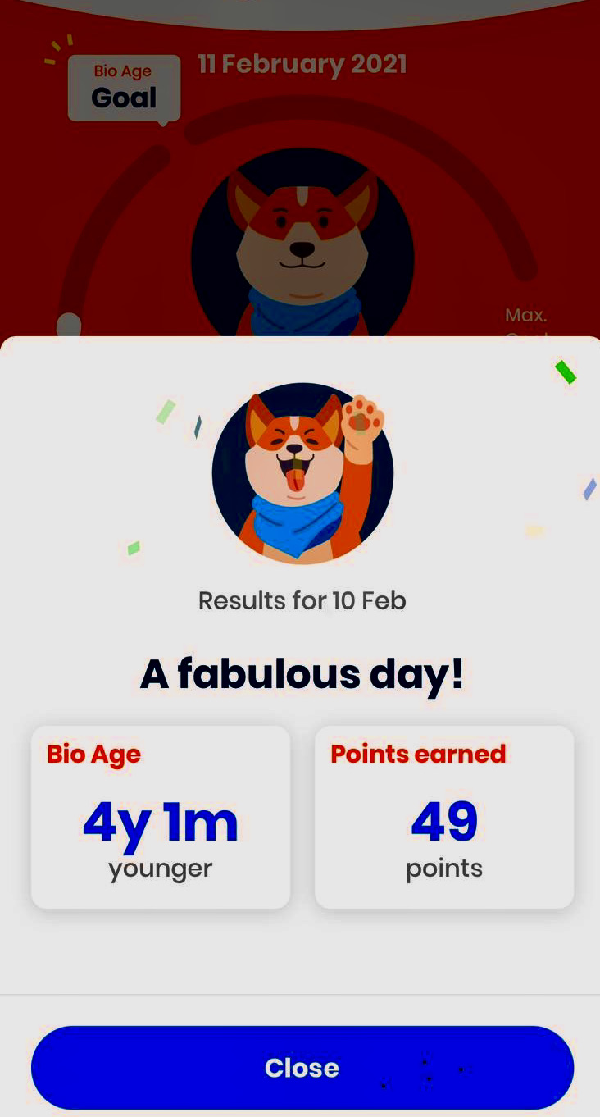
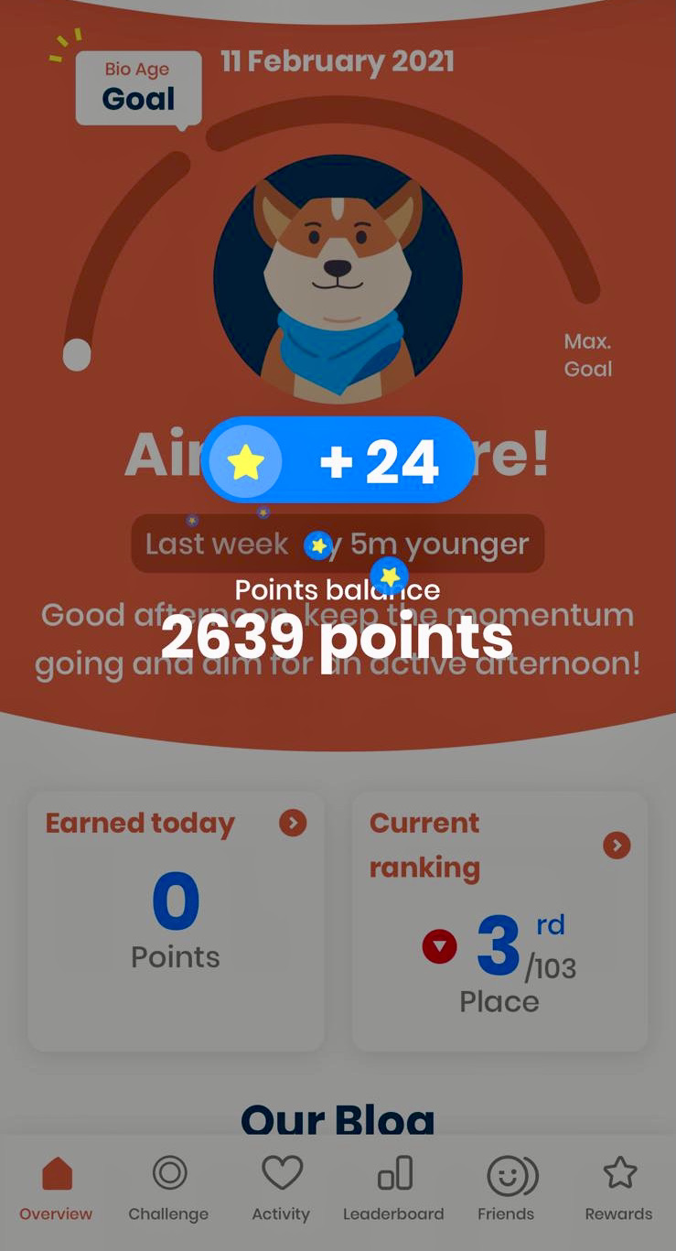
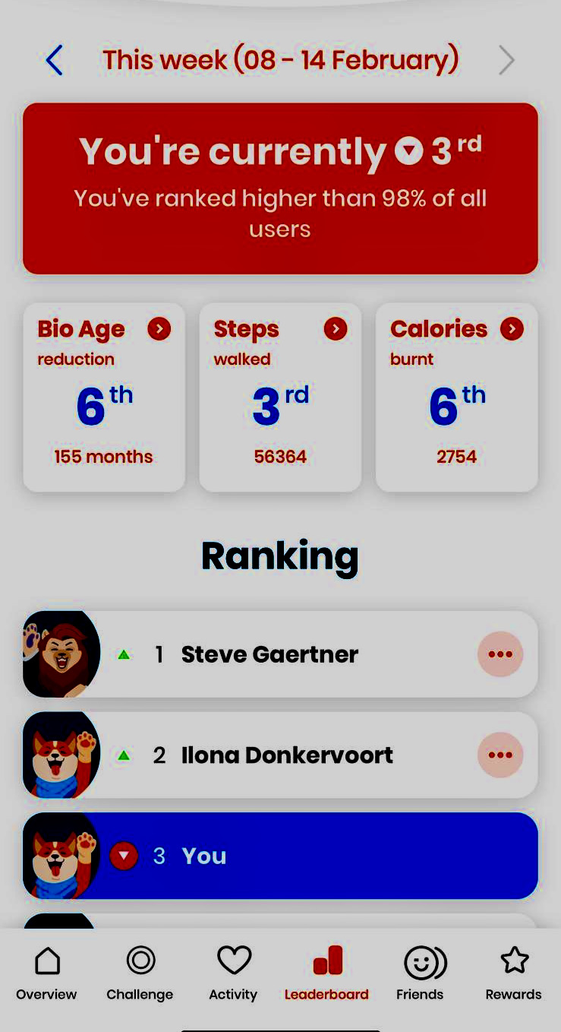
Recommendation Example
Advantageous for both insurer & the insured
the rewards and incentives on a regular basis is a significant gain plus staying in great shape keeps you positive to manage life
A Vitality Fitness App to keep the user engaged with regards to his/her physical activities like walk, jog, sleep, etc.
Incentivize the user with a lesser premium amount by basis of their bio age fitness level
Notes:
1) A Vitality Fitness App to keep the user engaged with regards to his/her physical activities like walk, jog, sleep, etc. The App will calculate the fitness level of the user and accordingly offer incentives and offers like discounts & freebies
2) This screenshot shows the user being fit and active. Such result could be reasons to incentivize the user with a lesser premium amount by calculating their bio age fitness level
3) Regular activity, monitoring and motivation encourages the user to stay involved and achieve better because the rewards and incentives on a regular basis is a significant gain plus staying in great shape keeps you positive to manage life.
4) A healthy and active customer is something that an insurance company would like to keep insured and engaged

Slide 19
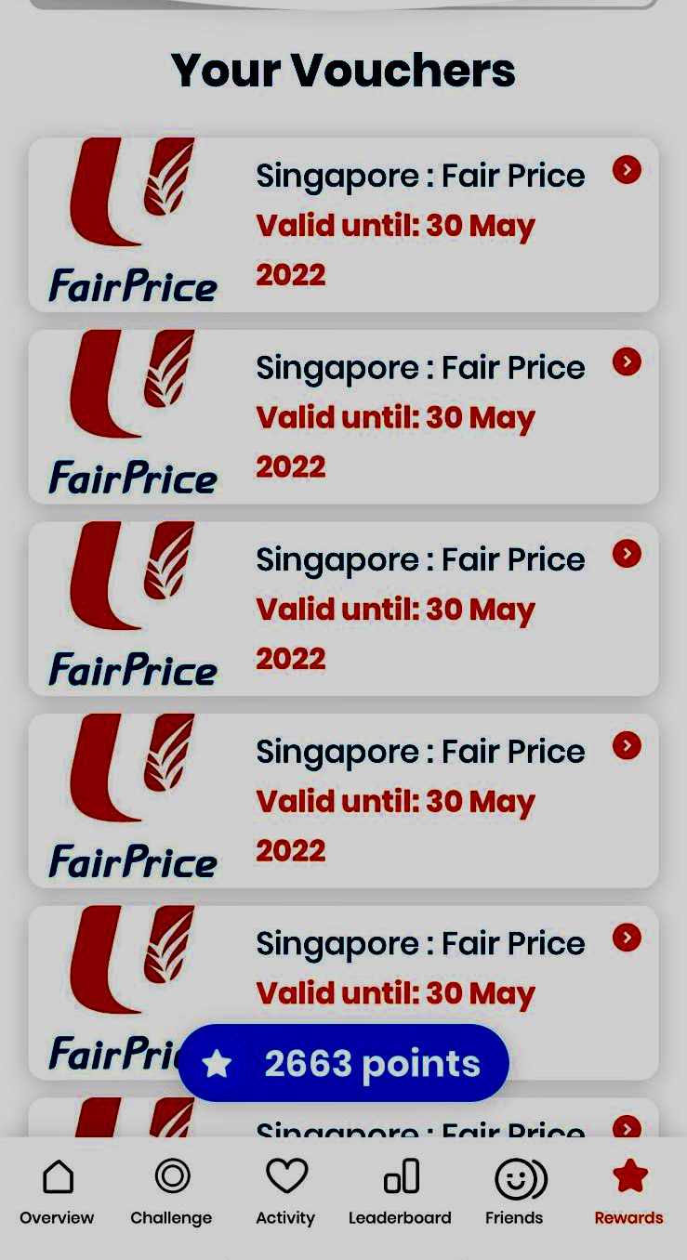
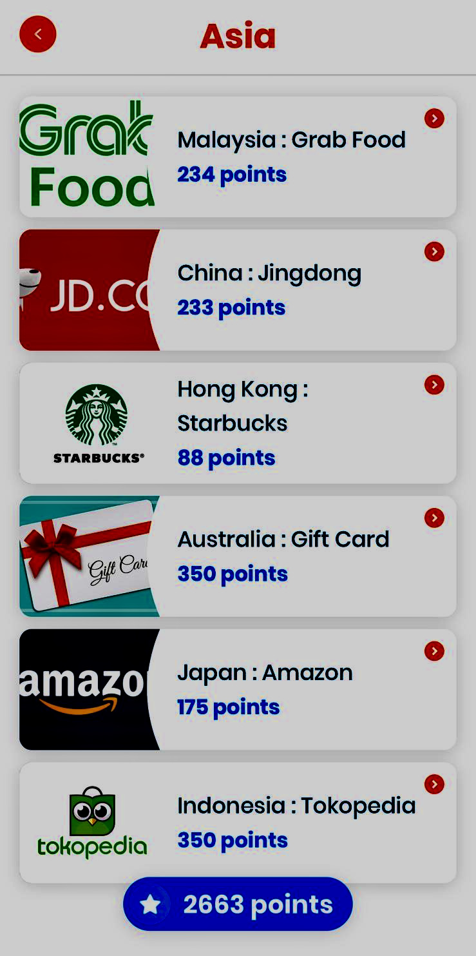
Recommendation Example
Benefits * Incentives * Rewards * Recognition * Discounts * Deferred payment options
Deferred period options for payment of premium**
More active and healthy = more attractive offerings on premiums**
a healthier customer = benefits from other financial & professional service**
**All stakeholders together create a ‘value prop” with customer at the center**
Variety of benefits ranging from daily refreshments, daily rides, vouchers for e-shopping
Groceries shopping vouchers. The more you stay fit – the more discounts you earn
Notes:
Deferred period for payment of premium (insurer is flexible with a healthy insurer and can afford to provide options for payment)
Rewarding with lesser premium for staying healthy and active . More active and healthy = more attractive offerings on premiums
A healthy fitness score card shared by insurer with other service providers like financial institutions, education, jobs & professional service . Such institutions would be more forthcoming to be engaged and offer services like loans etc. to a healthier customer as chances of recovering from a healthy person is always more and makes business sense.
All stakeholder could come together to create a “Value proposition” by keeping the customer in the center of things and create offerings in such a fashion that the customer find ”value” in more more ways than one to stay active and healthy

Slide 20
Thankyou
… end of presentation

